Slide 1
analyzing the Current health expenditure
By
Jun Ying

Slide 2
introduction
Dataset: Health Expenditure per Capita, Health Expenditure per GDP, Birth Rate, Hospital Beds, Life Expectancy, Population,
Number of Infant Deaths, Number of Physicians
Data Source: The World Bank
Using Packages: Pandas, Matplotlib.pyplot, Zipfile, plotly, numpy and Warnings

Slide 3
cleaning and preprocessing
Set_option: Setting number accuracy
Zipfile and Pandas: Opening and importing the data into python
years = ['2008','2009','2010','2011','2012','2013','2014','2015’]
Delete and dataframe.loc: cleaning and screening the data

Slide 4
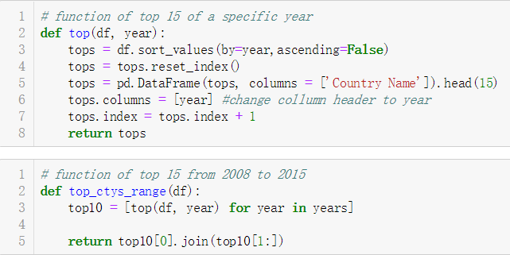
Create function to sort data frame
Create the first function in order to have a quick look of the top 15 of a specific year
Create the second function in order to gather the top 15 of each year
Use top_ctys_range(df) can conveniently and rapidly check the top 15 of each year

Slide 5
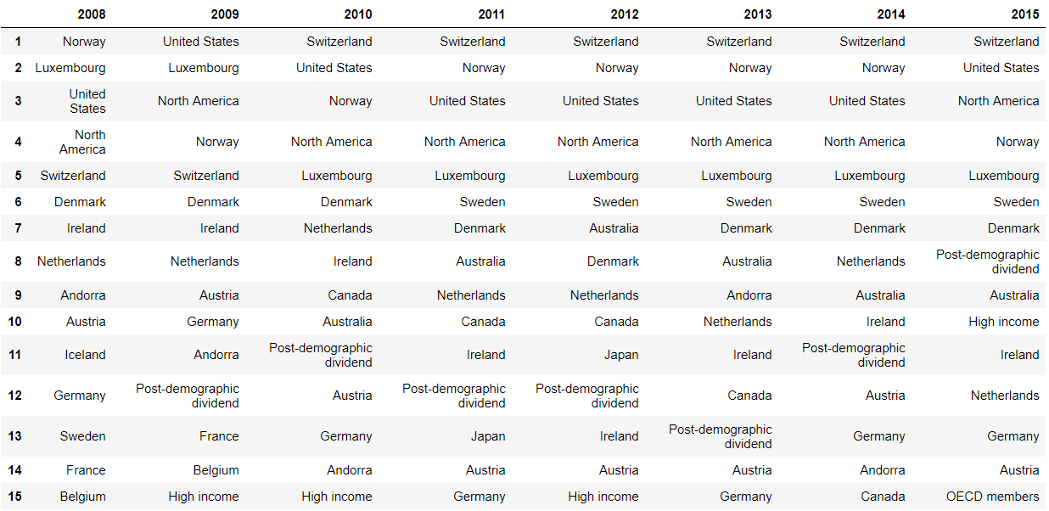
current health expenditure per capita between 2008 and 2015

Slide 6
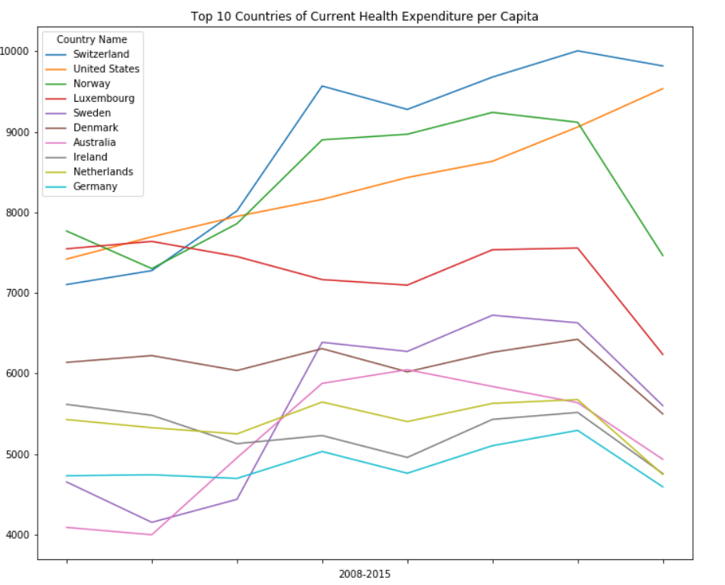
top 10 countries of current health expenditure per capita in 2015
ctycapita = ['Switzerland', 'United States', 'Norway', 'Luxembourg', 'Sweden', 'Denmark', 'Australia', 'Ireland', 'Netherlands', 'Germany’]
ctycapita_top10 = ctycapita_top10.stack().unstack(0)
Percapita_line = ctycapita_top10.plot.line(figsize=(12,10),
title='Top 10 Countries of Current
Health Expenditure per Capita')

Slide 7
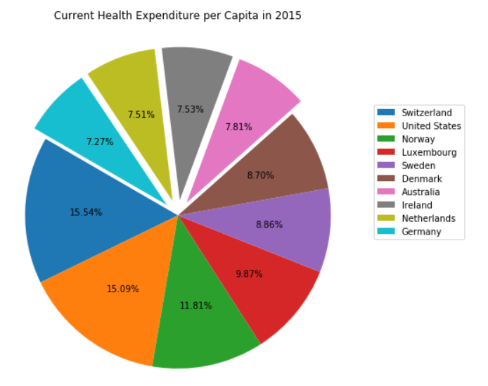
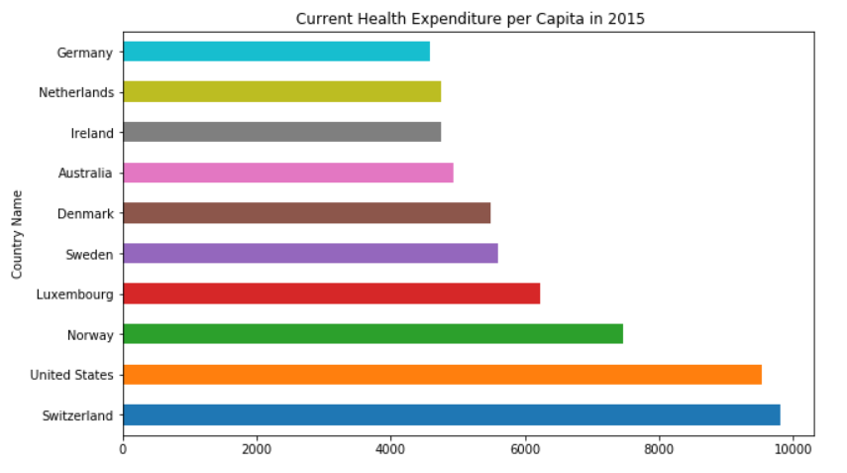
Bar chart & pie chart

Slide 8
Information of top 10
Create a dataframe of top 10 countries about their infant death, life expectancy, hospital beds and physicians in 2015
In order to check the health issues of these 10 countries
top10_ctycapita = pd.DataFrame({
'InfantDeath per 1000’:
infantdeath.loc[ctycapita,'2015’]/Pop.loc[ctycapita,'2015']*1000,
'InfantDeathRate’:
infantdeath.loc[ctycapita,'2015’]/Pop.loc[ctycapita,'2015']*1000
/birthrate.loc[ctycapita,'2015']*100,
'LifeExpectancy':lifespan.loc[ctycapita, '2015’],
'HospitalBeds per 1000':Hospbed.loc[ctycapita,'2015’],
'Physicians per 1000':Doc.loc[ctycapita, '2015']})

Slide 9
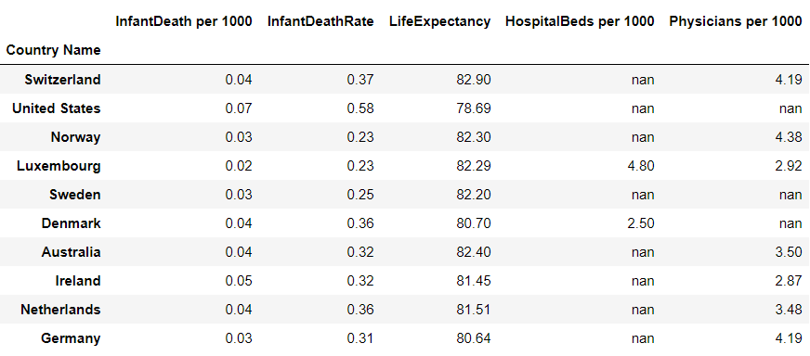
The mean of Infant Death per 1,000 people in 2015 is 0.69
The mean of infant death of the birth rate is 2.42%
The mean of life expectancy all over the world in 2015 is 71.75
The mean of Hospital beds per 1,000 people is 3.03
The mean of the number of physicians per 1,000 people is 2.45

Slide 10
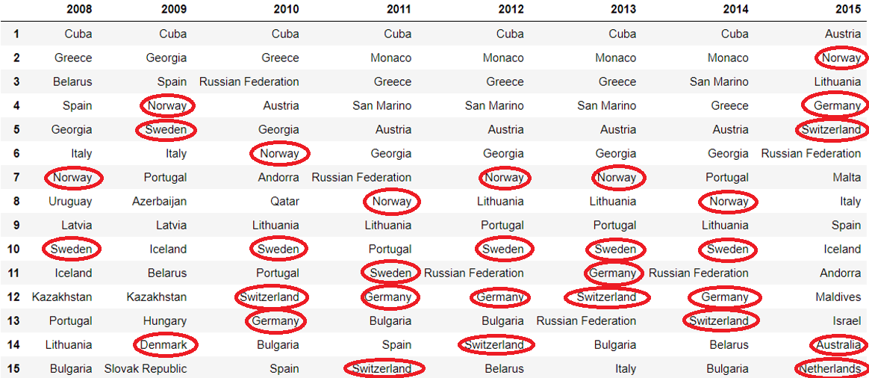
top 15 Physicians per 1,000 people between 2008 and 2015

Slide 11
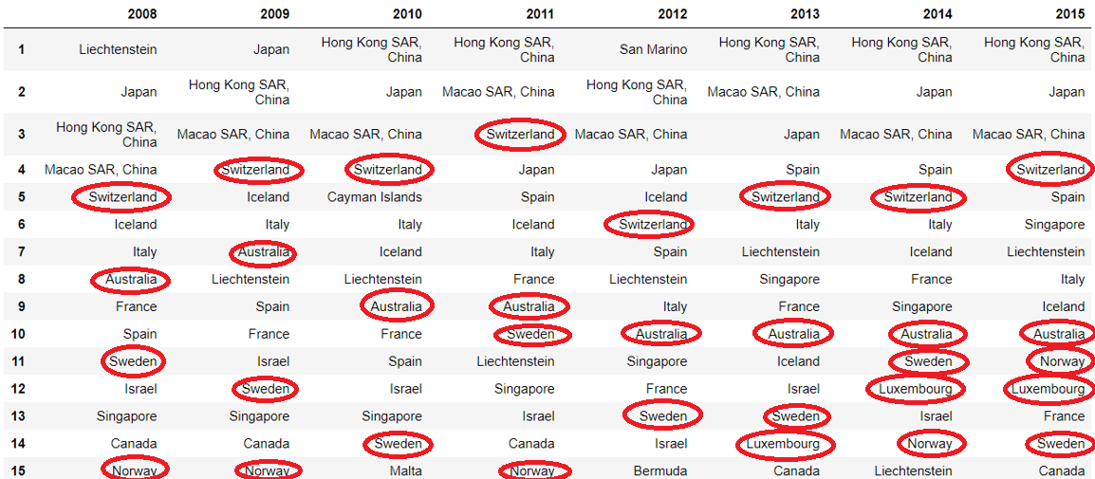
top 15 life expectancy between 2008 and 2015

Slide 12
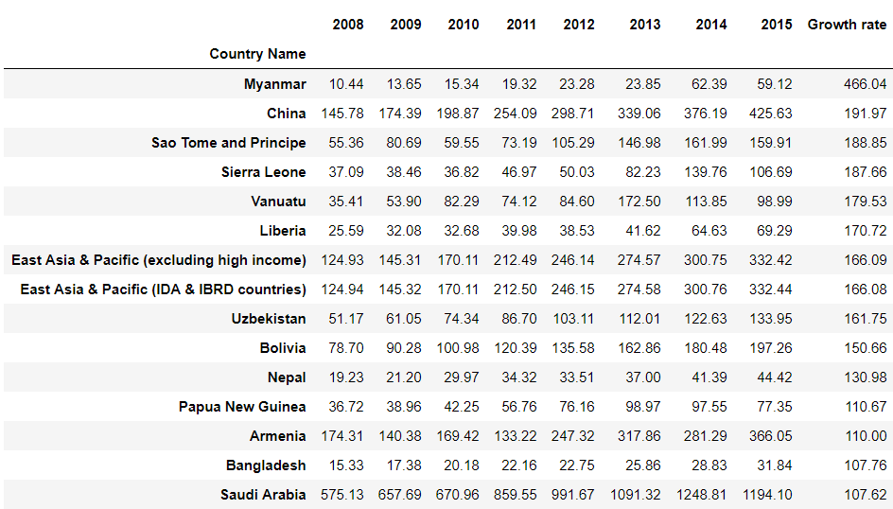
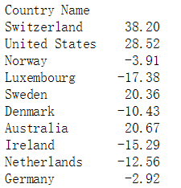
Growth rate of Health Expenditure per Capita from 2008 to 2015
Percapita['Growth rate'] = 100*(Percapita['2015'] - Percapita['2008'])/Percapita['2008’]
The health expenditure of a half of top 10 countries is decreasing.

Slide 13
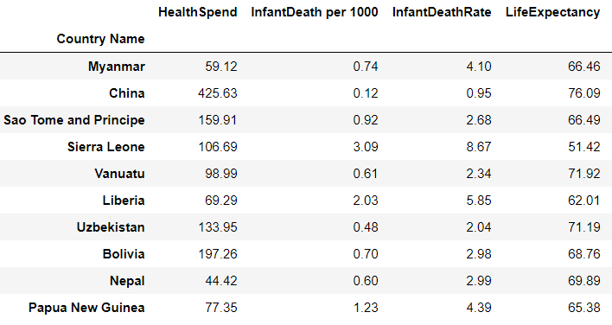
top 10 countries of the growth rate
ctycapita_growth = ['Myanmar','China’,
'Sao Tome and Principe','Sierra Leone','Vanuatu’,'Liberia’,
'Uzbekistan','Bolivia','Nepal’,
'Papua New Guinea’]
The mean of health spending all over the world in 2015 is 1005.96

Slide 14
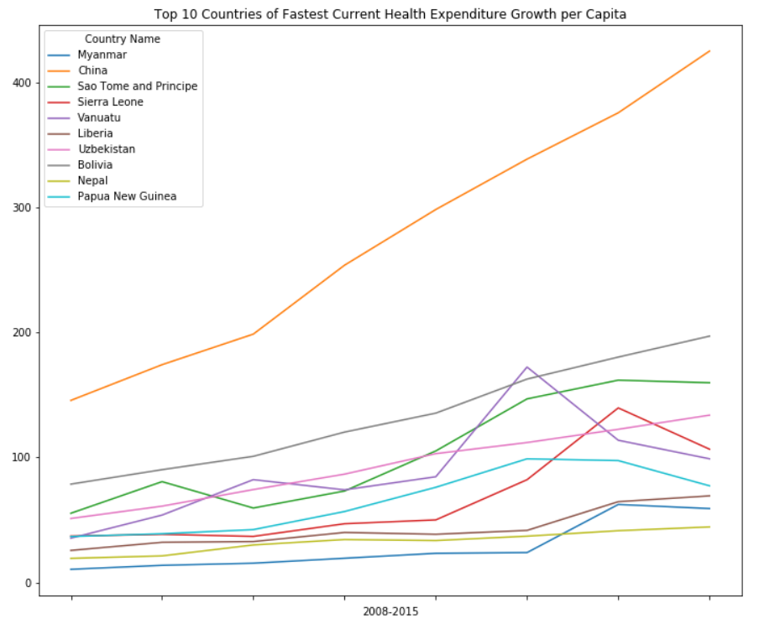
Line chart of top 10 growth rate countries
ctycapita_top10_rate = Percapita
ctycapita_top10_rate = ctycapita_top10_rate.loc[ctycapita_growth, years]
ctycapita_top10_rate = ctycapita_top10_rate.stack().unstack(0)
Percapita_line_rate = ctycapita_top10_rate.plot.line(
figsize=(12,10),
title='Top 10 Countries of Fastest Current Health Expenditure Growth per Capita')
Percapita_line_rate.set_xlabel('2008-2015')
plt.show()

Slide 15
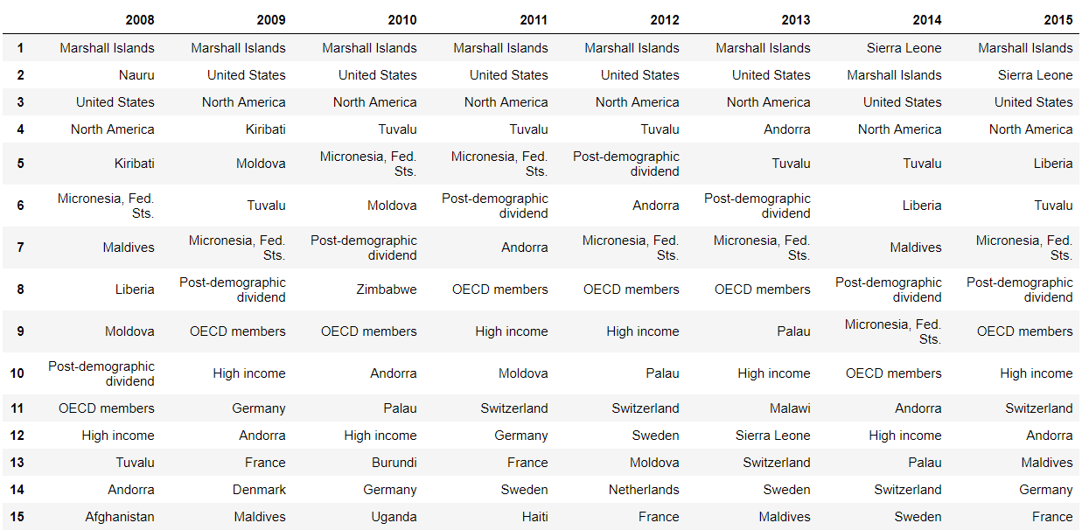
current health expenditure per GDP between 2008 and 2015

Slide 16
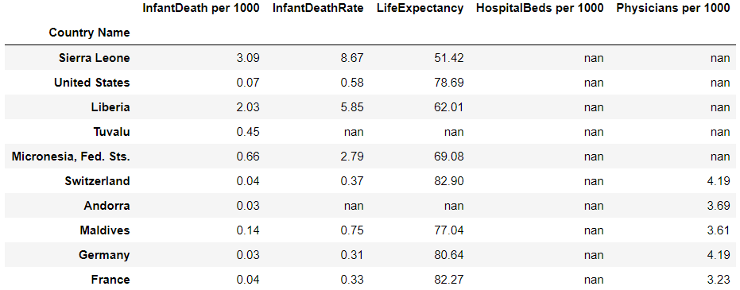
top 10 countries of current health expenditure per GDP in 2015
ctyGDP = ['Sierra Leone', 'United States', 'Liberia', 'Tuvalu', 'Micronesia, Fed. Sts.', 'Switzerland', 'Andorra', 'Maldives', 'Germany', 'France’]
top10_ctyGDP = pd.DataFrame({'InfantDeath per 1000':infantdeath.loc[ctyGDP,'2015']/Pop.loc[ctyGDP,'2015']*1000,
'InfantDeathRate':infantdeath.loc[ctyGDP,'2015']/Pop.loc[ctyGDP,'2015']*1000/birthrate.loc[ctyGDP,'2015']*100,
'LifeExpectancy':lifespan.loc[ctyGDP, '2015'],'HospitalBeds per 1000':Hospbed.loc[ctyGDP,'2015’],
'Physicians per 1000':Doc.loc[ctyGDP, '2015']})

Slide 17
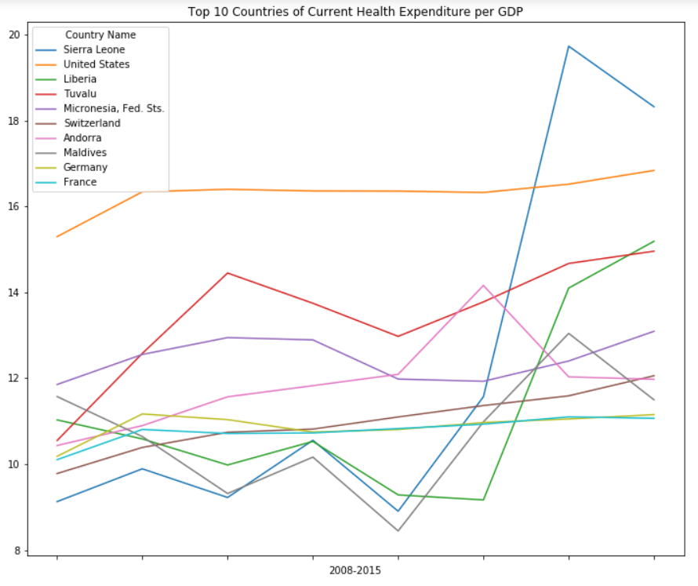
Outliers of top 10 countries of current health expenditure per GDP
There is a rapid gap of Sierra Leone and Liberia between 2013 and 2014.

Slide 18
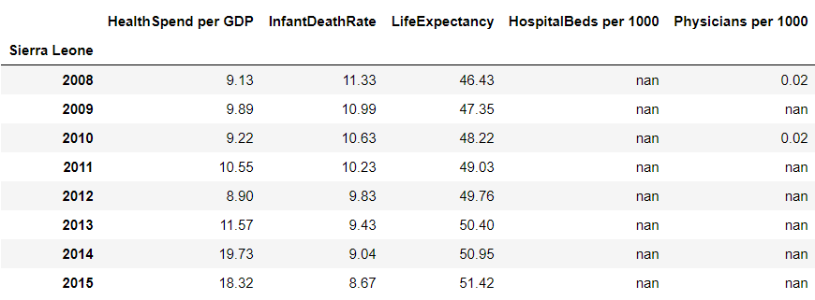
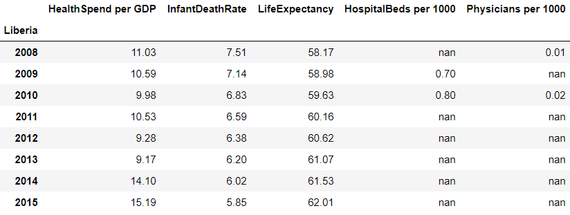
Outliers of top 10 countries of current health expenditure per GDP
Create data frames of these two countries and check the reason why the gap happened.

Slide 19
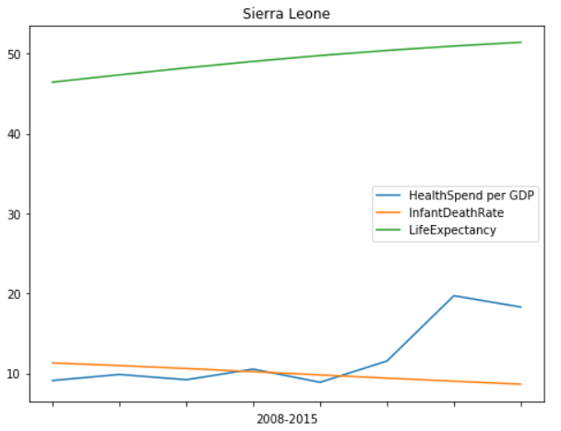
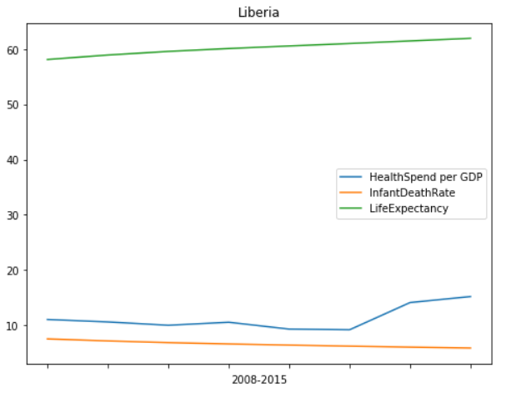
Line chart of the value of these two countries

Slide 20
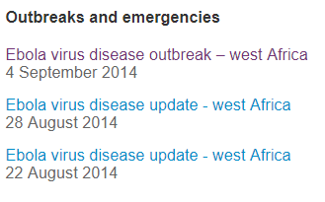
Reason of the Outliers
Sierra Leone and Liberia both are west Africa countries.
There was a outbreak of Ebola virus disease in 2014
Source: WHO (https://www.who.int/countries/sle/en/)

Slide 21
predictions
Because of saturation, the health expenditure of the top countries might gradually decrease.
The high-speed developing countries, like Chine, will soon catch up with developed countries.
Although outbreaks and emergencies, the health expenditure per GDP of the affected countries will decrease sluggishly.

Slide 22
learning & conclusion
After finishing this project, I learnt how to find datasets which would be useful for my analyzation and understand what kind of graphic or table is suitable in which situation.
In light of the above, the health expenditure per capita are almost from Europe, and most of them are developed countries, developing countries, like China, are catching up at an rapid rate.
the health expenditure per capita can influence the health of citizen, because there would be much more fund for construction of medical if the health expenditure are large.
The health expenditure per GDP can be influenced by outbreaks and emergencies, for example the outbreak of Ebola virus disease in 2014.

